Slide 1
Lecture 15
Nick Rugai PhD

Slide 2
Object-Oriented Programming
Based on the idea of “objects”.
An object is both data (state) and code (behavior).
In python, the class type is the prototypical object.
A class can be crated many times and they are all independent from each other:
These go by the name of instances.
The creation of an instance goes by instantiation.

Slide 3
Classes
Classes are not function calls.
You cannot create an instance of a function:
You can only call a function
In Python, class names are usually capitalize.
>>> class Point:
class Point is a factory about to produce many obejcts
>>> blank = Point()
blank is an instance of Point

Slide 4
Classes
>>> Point
>>> blank
You can assign new variables to an instance:
>>> blank.x=4.4 # this is called an attribute
>>> blank.y=1.2
>>> z=blank.x/blank.y
>>> z

Slide 5
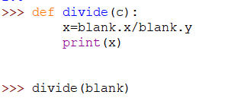

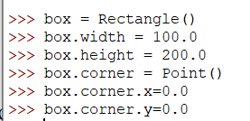
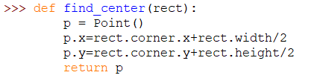
Classes
You can pass an instance down as an argument
Notice the double dot because is an instance
within another instance
Function can return instances

Slide 6


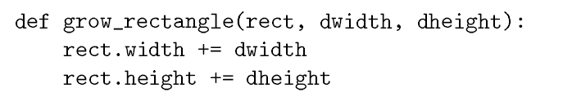
Classes
Inside a function p is an alias for blank
Objects are mutable
Functions can modify objects
rect is an alias for box

Slide 7
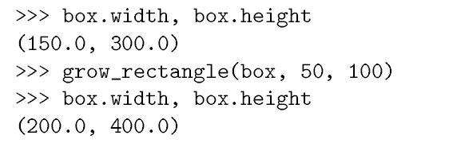
Classes
Aliasing can be dangerous! The same memory can be accessed by several sources
Aliasing can be hard to understand within the code.

Slide 8
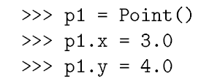

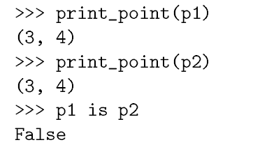
Classes
Copying an instance is a good alternative to aliasing
p1 and p2 are not the same object!

Slide 9
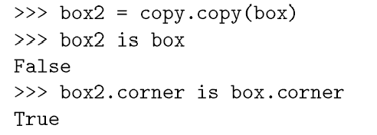
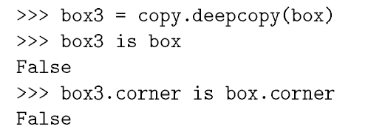
Classes
Vs.
Shallow Copy:
Embedded objects not copied
Deep Copy:
Embedded objects copied
box and box 3
are entirely different objects!

Slide 10
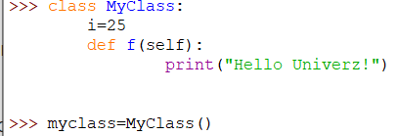

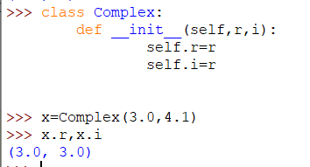
Classes
self represents the instance of the class,
you must use it!
__init__ is the default initializing function:
2Xunderscore+init+2Xunderscores

Slide 11
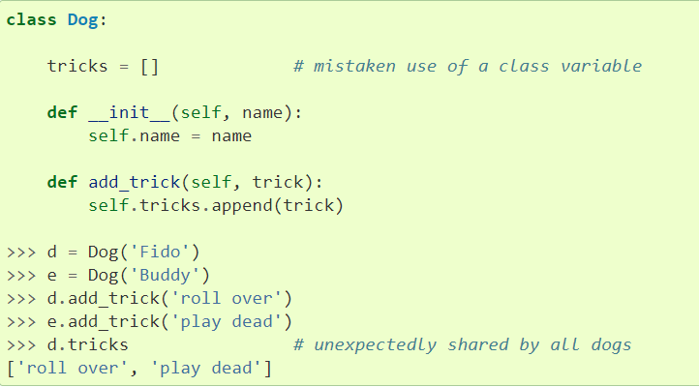
Classes
Mutable objects such as lists and dictionaries are shared!!! Be careful!

Slide 12
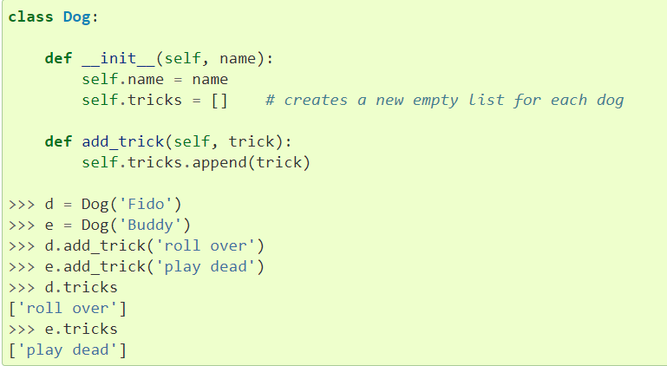
Classes
This is the correct way of using a list within a class.

